Slide 1
House Keeping: Semester 2!
It is a do or break semester.
We will work even harder this semester.
Clinical Rotations and ward Attendance Mandatory
There will be 3 CATs as per schedule.
All the best.

Slide 2
Worries/Questions

Slide 3
Topics
Introduction to principles of Endocrinology;
Hormones and Mechanisms of action;
Diagnostic tests in Endocrine practice
Adrenal cortex and diseased;
Adrenal medulla and diseases;
Gonads and related diseases;
Neuroendocrine disorders

Slide 4
Topics …
Type 1 Diabetes, Pathogenesis & Insulin therapy; Type2 diabetes, pathogenesis, Oral Antidiabetic agents & holistic management;
Diabetic Emergencies
Diabetes in special situations
& gestational diabetes;
Hypothalamus and Pituitary;
anatomy and endocrine functions;
Thyroid disorders;
Vit.D , PTH, and Bone diseases;

Slide 5
Introduction To Endocrinology

Slide 6
Introduction to principles of Endocrinology
Hormones and Mechanisms of action
Diagnostic tests in Endocrine practice

Slide 7
What are the elements of an endocrine system?
Sender = Sending Cell
Signal = Hormone
Nondestructive Medium = Serum & Hormone Binders
Selective Receiver = Receptor Protein
Transducer = Transducer Proteins & 2º Messengers
Amplifier = Transducer/Effector Enzymes
Effector = Effector Proteins
Response = Cellular Response (2º Hormones)

Slide 8
Endocrine system
A group of glands which have NO ducts.
Secrete their hormones into blood & extracellular fluid.
Most hormones circulate in blood, & come in contact with essentially all cells.

Slide 9
Endocrine system … (continued)
A given hormone usually affects only a limited number of cells, called target cells.
Target cell responds in specific way to a hormone as it bears specific receptor proteins for
the hormone.

Slide 10
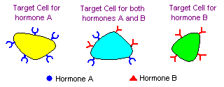
A cell is a target because it has a specific receptor for the hormone.

Slide 11
The endocrine system
Endocrine glands
Hormone
Regulate specific function
Receptor (target organs )

Slide 12
Hormonal Interactions
❖ Synergistic:
• Two hormones work together to produce a result.
❖ Additive:
• Each hormone separately produces response, together at same concentrations stimulate even greater effect.
• NE and Epi.
❖ Complementary:
• Each hormone stimulates different step in the process.
• FSH and testosterone.

Slide 13
Endocrine system … (continued)
Distance between hormone producer cell & hormone responder cell may be large, moderate, or small.
Generally, act slower in onset, more prolonged, & more diffuse than NS.
Under control of NS.

Slide 14
Principal functions of the endocrine system
★ Maintenance of internal environment (homeostasis).
★ Regulation total body metabolism.
★ Control of energy production, utilization & storage.
★ Integration & regulation of growth & development.
★ Control, & maintenance of sexual reproduction, including gametogenesis, fertilization, fetal growth & development & nourishment of the newborn.
★ body’s response to environmental stimuli.

Slide 15
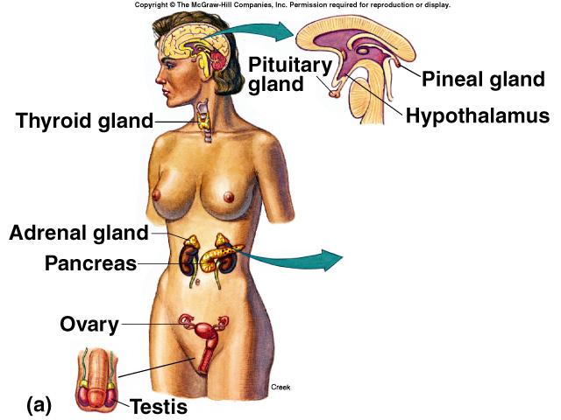
Important endocrine glands & organs
⬥ Pituitary gland (anterior & posterior)
⬥ Thyroid gland
⬥ Parathyroid gland
⬥ Adrenal gland
(cortex & medullae)
⬥ Islets of Langerhans in Pancreas
⬥ Ovaries
⬥ Testes
⬥ Placenta

Slide 16
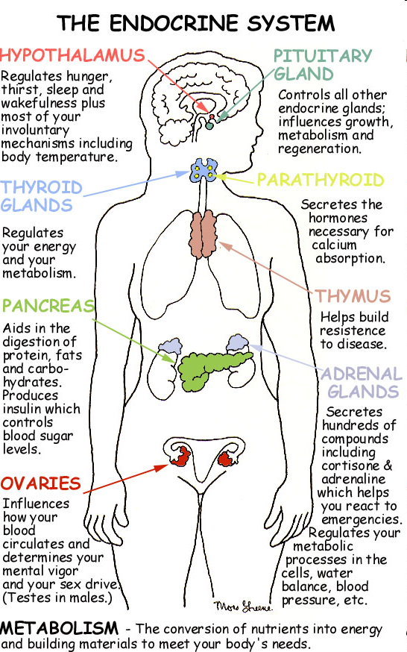

Slide 17
What is the classical endocrine system?
We now know that nearly every tissue secretes chemical signals that act as hormones; heart, immune cells, stomach, intestines, bone cells, liver, skin, glial cells, etc.

Slide 18
Endocrine glands … (continued)
Hormones & hormone-like substances are also produced by other organs in the body that serve other functions as well; such as:
Heart
→ Atrial natriuretic peptide (ANP)
Liver
→ Somatomedins (insulin-like growth factors IGF-1)
Adipose tissue
→ Leptin
kidneys
→ Erythropoietin

Slide 19
Types of glands.
Exocrine glands have channels or ducts, which secrete chemicals such as saliva or sweat.
Endocrine glands don’t have ducts. They secrete hormones directly into your bloodstream

Slide 20
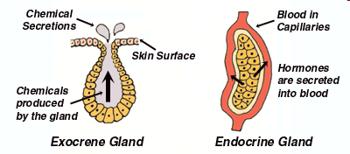

Slide 21
Coordination of body functions by chemical messengers .
The multiple activities of the cells, tissues ,and organs of the body are coordinated by the interplay of several types of chemical messenger systems:
Neurotransmitters are released by axon terminals of neurons into the synaptic junctions and act locally to control nerve cell functions .
Endocrine hormones are released by glands or specialized cells into the circulating blood and influence the function of cells at another location .
Neuroendocrine hormones are secreted by neurons into the circulating blood and influence the function of cells at another location in the body .
Paracrines are secreted by cells into the extracellular fluid and effect neighboring cells of different type .
Autocrines are secreted by cells into the extracellular fluid and affect the function of the same cells that produced them .
Cytokines are peptides secreted by cells into the extracellular fluid and can function as autocrines ,paracrine ,or endocrine hormones (interleukins,and lymphokines) .

Slide 22
Chemical structure of hormones
There are three general classes of hormones :
1- protein and polypeptide hormones ,including hormones secreted by anterior and posterior pituitary gland ,the pancreas (insulin and glucagons), parathyroid gland (parathyroid hormone ) .
2-Steroid hormones secreted by the adrenal cortex (cortisol and aldosterone), the ovaries (estrogen and progesterone ), the tests (testosterone ), and the placenta (estrogen and progesterone ).
3- Derivative of the amino acid tyrosine hormones ,secreted by thyroid (thyroxin and triiodothyronine ) and the adrenal medullae (epinephrine and norepinephrine ).

Slide 23
Endocrine Glands, Hormones , and their functions and : structure

Slide 24
Chemical structure | Major factors | Hormones | Gland tissue
- Peptide - Peptide Peptide - Peptide - Peptide - Amine - Peptide - Peptide | - Stimulates secretion of TSH and Prolactin - Causes release of ACTH. Causes release of growth hormone . Inhibits release of growth hormone . Causes release of LH and FSH - Inhabits release of Prolactin - Increase water reabsorption by the kidneys and causes vasoconstriction and increased blood pressure . - Stimulates milk ejection from breasts & uterine contractions | - Thyrotropin –releasing hormone TRH - Corticotrophin-releasing hormone CRH - Growth hormone -releasing hormone (GHRH). - Growth hormone inhibitory hormone (GHIH). - Gonadotropin-releasing hormone (GnRH). - Dopamine or Prolactin-inhibiting factor (PIF). Antidiuretic hormone (ADH) - Oxytocin | Hypothalamus Posterior pituitary

Slide 25
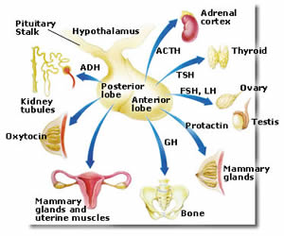

Slide 26
- Peptide - Peptide - Peptide - Peptide - Peptide - Peptide | - Stimulates protein synthesis and overall growth of most cells and tissues - Stimulates protein synthesis and secretion of thyroid hormones (T3,T4) - Stimulates protein synthesis and secretion of adrenocortical hormones. - Promotes development of the female breasts and secretion of milk - Causes growth of follicles in the ovaries and sperm maturation in sertoli cells of testes - Stimulates testosterone synthesis in leydig cells of testes , stimulates ovulation , formation of corpus luteum , estrogen and progesterone synthesis in ovaries | - Growth hormone - Thyroid-stimulating hormone (TSH). - Adenocorticotropic hormone (ACTH). - Prolactin - Follicle-stimulating (FSH) - Luteinizing hormone (LH). | Anterior pituitary

Slide 27
- Amine - Peptide - Steroid - Steroid - Amine -Peptide -Peptide -Peptide | - Increases the rates of chemical reactions in most cells ,thus increasing the body metabolic rate Promotes deposition of calcium in the bones and decreases extracellular fluid calcium in the bones and decrease extracellular fluid calcium ion concentration - Has multiple metabolic functions for controlling metabolism of proteins ,carbohydrates, and fats, also has anti inflammatory effects . - Increase renal sodium reabsorption ,potassium secretion ,and hydrogen ion secretion Same effect as sympathetic stimulation - Promoted glucose entry in many cells and in this way controls carbohydrate metabolism - Increases synthesis and release of glucose from the liver into the body fluids - Controls serum calcium ion concentration by increasing calcium absorption by gut and kidneys and releasing calcium from bones . | - Thyroxin T4 and triiodothyronine T3. - Calcitonin - cortisol - Aldosterone Norepinephrine ,epinephrine - Insulin - Glucagon - Parathyroid hormones (PTH) | Thyroid Adrenal cortex Adrenal medulla pancreas Parathyroid

Slide 28
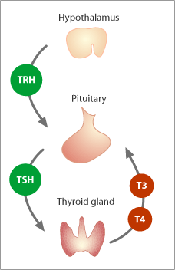

Slide 29
-Steroid - Steroid - Steroid Peptide - Peptide - Steroid - Steroid - Peptide - steroid | - Promotes development of male reproductive system and male secondary sexual characteristics. - Stimulates secretion uterine milk by the uterine endometrial glands and promotes development of secretory apparatus of breasts . - Promote growth and development of female reproductive system ,female breasts ,and female secondary sexual characteristic s - Promotes growth of corpus luteum and secretion of estrogens and progesterone by corpus luteum . - Probably helps promote development of some fetal tissues as the mother’s breasts - Catalyzes conversion of angiotensinogen to angiotensin-1(acts as an enzyme( - Increases intestinal absorption of calcium and bone mineralization. - Increase erythrocyte production | - Testosterone -Progesterone - Estrogens - Human chorionic Gonadotropin (HCG) - human somatomammotropin - Estrogen - Progesterone Renin - 1,25- dihydroxycholecalciferol - Erythropoietin | Testes Ovaries Placenta Kidney

Slide 30
Hormone secretion, transport, and clearance from the blood
-onset of hormone secretion after a stimulus , and duration of action of different hormones:
Some hormones such as norepinephrine and epinephrine ,are secreted within seconds after the gland is stimulated ,and they may develop full action within another few seconds to minutes.
Some hormones such as thyroxin or growth hormone ,may require month for full effect.
-concentrations of hormones in the circulating blood , and hormonal secretion rates .
The concentrations of hormones required to control most metabolic and endocrine functions are incredibly small.
Their concentrations in the blood range from as little as 1 picogram in each milliliter of blood up to at most a few micrograms per milliliter of blood .

Slide 31
Feedback control of hormones secretion
1- Negative feedback prevents overactivity of hormones systems:
the plasma concentrations of many hormones fluctuate in response to various stimuli that occur through out the day, and appeared to be closely controlled .
this control is exerted through negative feedback mechanisms that ensure a proper level of hormone activity at the target tissue .
After stimulus causes release of the hormone ,conditions or products resulting from the hormone tend to suppress its further release .
In other words , the hormone (or one of its products ) has a negative feedback effect to prevent over secretion of hormone or overactivity at the target tissue .
2-surges of hormones can occur with positive feedback :
The positive feedback occurs when the biological action of hormone causes additional secretion of the hormone .
One example of this is the surge of luteinizing hormone(LH) that occurs as a result of the stimulatory effect of estrogen on the anterior pituitary before ovulation .

Slide 32
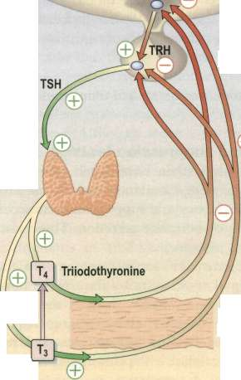
Hypothalamus
Thyroid
negative feedback
Peripheral conversion
The hypothalamic-pituitary-thyroid axis.

Slide 33
What are feedback systems?
Feedbacks Generate Control Loops
Negative
These maintain hormonal balance & are often linked to homeostatic processes.
If the multiplicative effect of the several links in a control loop is negative, the entire control loop is negative.
Positive
These cause physiologic changes in the system involved.
If the multiplicative effect of the several links in a control loop is positive, the entire control loop is positive.
+
--
+
+

Slide 34
3- Cyclical variations occur in hormone release :
Superimposed on the negative and positive feedback control of hormone secretion are periodic variation in hormone release that are influenced by seasonal changes , various stages of development and aging , the diurnal (daily) cycle ,and sleep .
for example , the secretion of growth hormone is markedly increased during the early period of sleep but is reduced during the later stage of sleep.
In many cases ,these cyclical variations in hormone secretion are due to changes in activity of neural pathways involved in controlling hormone release .

Slide 35
Transport of hormones in the blood
Water –soluble hormones (peptide and catecholamine) are dissolved in the plasma and transported from their sites of synthesis to target tissue ,where they diffuse out of the capillaries ,into the interstitial fluid , and ultimately to target cells.
Steroid and thyroid hormones ,in contrast ,circulate in the blood mainly bound to plasma proteins .
For example : more than 99 per cent of the thyroxin in the blood is bound to plasma proteins .
however, protein bound hormones can not easily diffuse across the capillaries and gain access to their target cells and are therefore biologically inactive until they dissociate from plasma proteins .

Slide 36
Clearance of hormones from the blood
Two factors can increase or decrease the concentration of a hormone in the blood .
The first one is the rate of hormone secretion into the blood .
The second one is the rate of removal of the hormone from the blood , which is called the metabolic clearance rate .

Slide 37
Hormones are cleared from the plasma in several ways including :
1- metabolic destruction by the tissues .
2- binding with the tissues .
3- excretion by the liver into the bile
4- excretion by the kidney into the urine
For certain hormones ,a decreased metabolic clearance rate may cause an excessively high concentration of the hormone in the circulating body fluids . For instance ,this occur for several of the steroid hormones when the liver is diseased , because these hormones are conjugated mainly in the liver and then (cleared ) into the bile .
Hormones are sometimes degraded at their target cells by enzymatic process that cause endocytosis of the cell membrane hormone –receptor complex: the hormone is then metabolized in the cell, and the receptors are usually recycled back to the cell membrane .

Slide 38
Mechanism of action of Hormones
The first step of a hormone’s action is to bind to specific receptors at the target cell.
Hormonal receptors: are large proteins, and each cell that is to be stimulated usually has some 2000 to 100,000 receptors. also., each receptor is usually highly specific for a single hormone.
Target tissue: the target tissues that are affected by a hormone are those that contain its specific receptors.

Slide 39
What is a hormone receptor?
Hormone Receptors are cellular proteins that bind with high affinity to hormones & are altered in shape & function by binding; they exist in limited numbers.
Binding to hormone is noncovalent & reversible.
Hormone binding will alter binding to other cellular proteins & may activate any receptor protein enzyme actions.

Slide 40
What are transducers?
Transducers are proteins that convert the information in hormonal signals into chemical signals understood by cellular machinery.
They change their shape & activity when they interact directly with protein-hormone complexes.
Usually enzymes or nucleotide binding proteins, they produce 2nd messengers, or change the activity of other proteins by covalently modifying them (adding or removing phosphate, lipid groups, acetate, or methyl groups), or they interact with other proteins that do these things.
They begin amplifying the energy content of the original hormone signals.

Slide 41
What are effectors?
Effectors are the enzymes & other proteins that convert the transduced hormonal signal into biochemical changes that generate the cellular response to hormone binding.
Usually amplify the signal further & allow cellular work to be done: cell motion, growth, division, altered metabolism, secretion, depolarization, etc.

Slide 42
Location of hormone receptors
1- In or on the surface of the cell membrane:
the membrane receptors are specific for protein, peptide, and catecholamine hormones.
2- In the cell cytoplasm: the cytoplasmic receptors are specific
For steroid hormones.
3- In the cell nucleus: the receptors for the thyroid hormones are found in the nucleus .

Slide 43
Communication among cells & organisms & between organisms & their environment is absolutely central to life & reproduction. While many of the basics of endocrine communication are known, we are continually surprised by new findings that revise our existing knowledge. Many, of the details of endocrine molecular biology, genetics, cell biology, & development remain to be defined. As one of the most dynamic & central of the biomedical sciences for practitioners, paramedical professions, & basic scientists, endocrinology will continue to be a vital science for many years to come.
Conclusions:

Slide 44
Common endocrine disorders
Thyroid disorders; (the most common problems are thyrotoxicosis, primary hypothyroidism and goitre)
Subfertility, affecting 5-10% of all couples
Osteoporosis, especially in postmenopausal women
Primary hyperparathyroidism
Disorders of growth or puberty

Slide 45
Aetiology of endocrine disease
Autoimmune disease
Endocrine tumours
Enzymatic defects
Receptor abnormalities

Slide 46
questions

